Slide 1
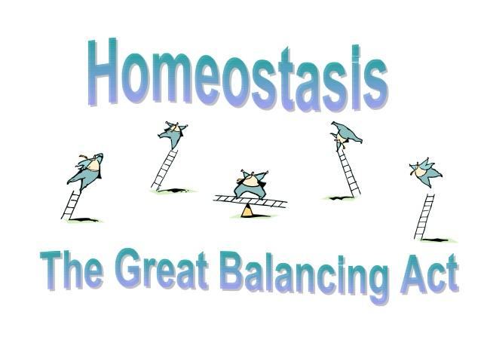

Slide 2
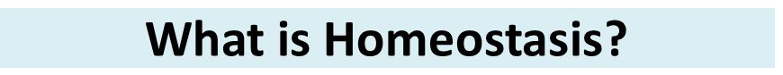
Greek word homoios (same) and stasis (to stand)
Homeostasis is the ability of organisms to auto-regulate and maintain their internal environment in a stable state despite external changes.
For example, during blood clotting, a cascade of homeostatic events occurs leading to prevention of blood loss.
Why do we need homeostasis ?
Cells depend on the body environment to live and function.
Homeostasis keeps the body environment under control and keeps the conditions right for the cells to live and function.
All living organisms, from plants to puppies to people, must regulate their internal environment to process energy and ultimately survive.
Notes:
The concept of homeostasis was first articulated by the French scientist Claude Bernard.
Homeostatic mechanisms help maintain stable internal conditions. Even though conditions outside of an animal's body may vary widely, the inside stays relatively constant due to many finely tuned control systems.
Example of homeostasis in plants: Opening and closing of stomata to prevent water loss, Plants in colder climates also have to protect themselves against the cold. For example, deciduous trees drop their leaves in cold weather to reduce their metabolism.

Slide 3
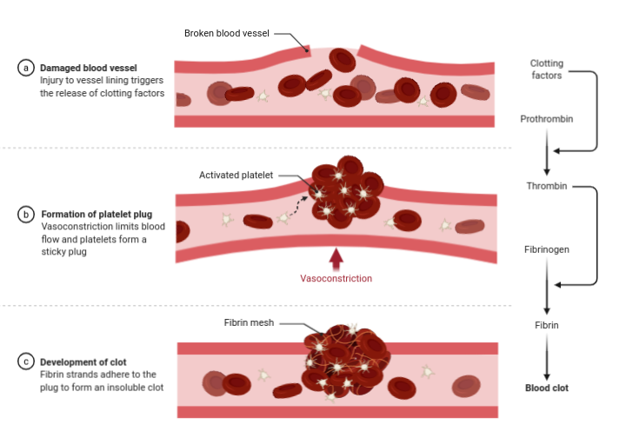

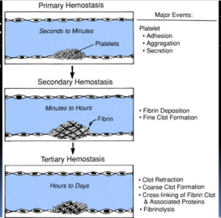
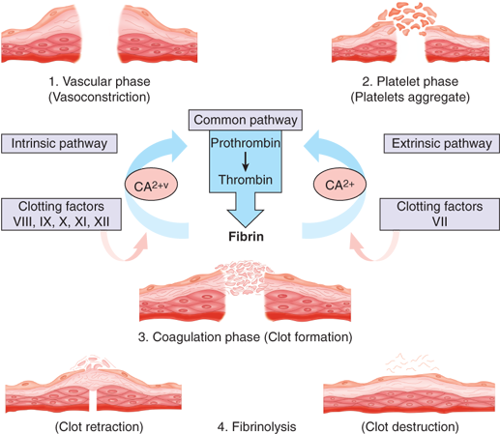
BLOOD CLOTTING
Notes:
For example, during blood clotting, a cascade of homeostatic events occurs leading to prevention of blood loss.
Blood clotting or hemostasis occurs in three major steps
Primary hemostasis - Vasoconstriction and platelet plug formation - usually takes seconds to minutes.
Secondary hemostasis - Formation of fibrin plug or blood clot through coagulation cascade - minutes to hours
Tertiary hemostasis - Clot retraction and Fibrinolysis i.e., shrinkage of clot and secretion of serum and dissolution of clot - hours to days
Clot retraction is the "shrinking" of a blood clot over a number of days. In doing so, the edges of the blood vessel wall at the point of injury are slowly brought together again to repair the damage that occurred.

Slide 4
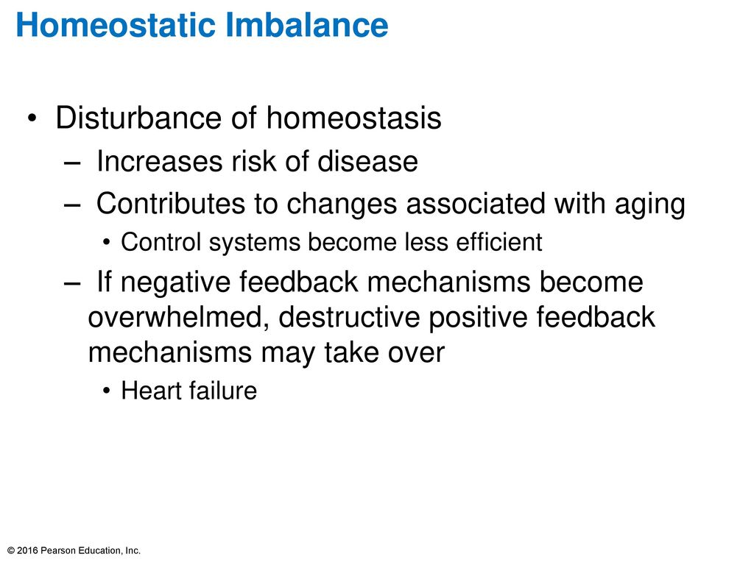
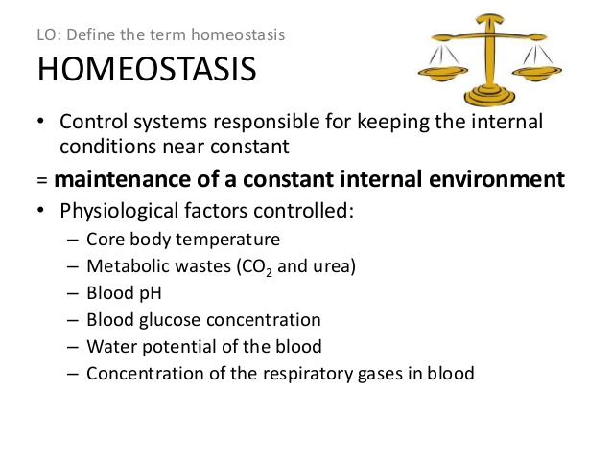
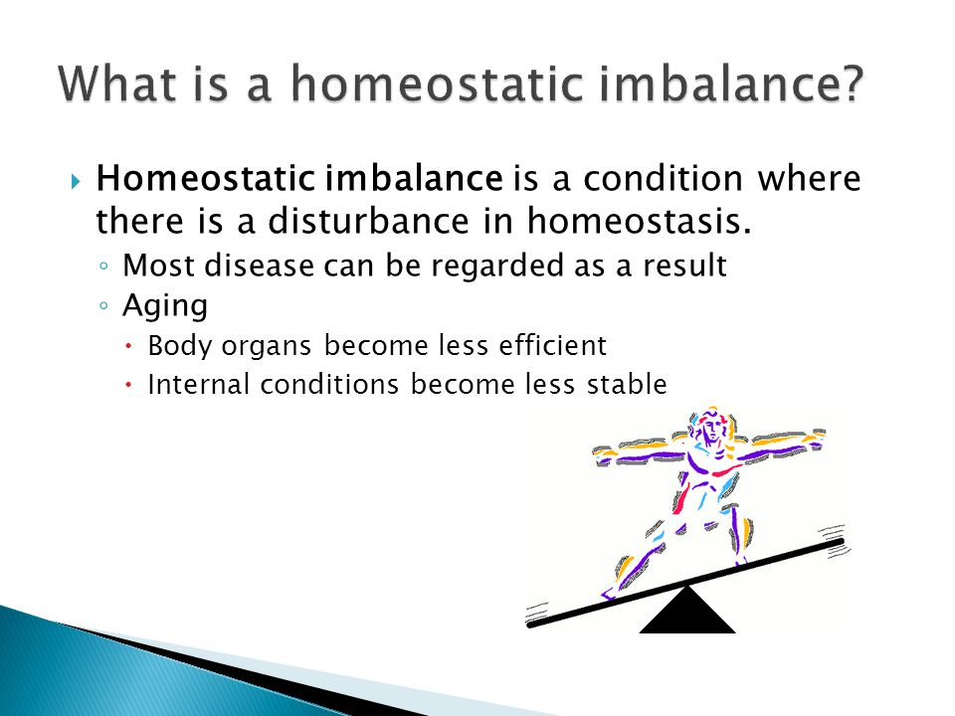
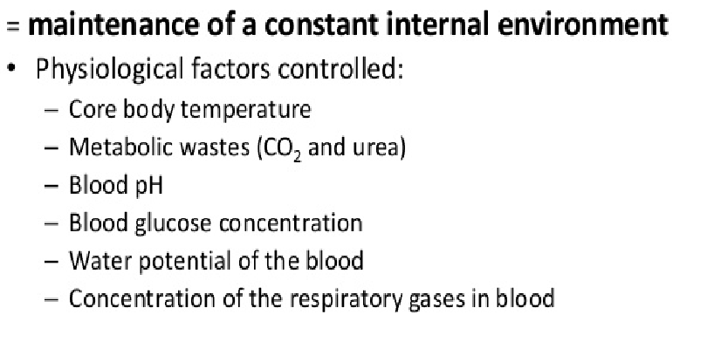
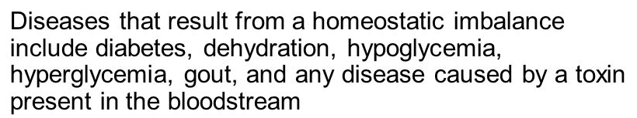
Disruption of homeostasis results in various diseases due to
1. Deficiency (cell not getting all they need)
2. Toxicity (cells being poisoned by things
they do not need)
Severe imbalances can cause death
– concentration of respiratory gases in blood
– blood pressure
– essential salts and minerals,
– levels of hydration in a cell etc.
Notes:
Many diseases are a result of homeostatic imbalance, an inability of the body to restore a functional, stable internal environment.
Aging is a source of homeostatic imbalance as the control mechanisms of the feedback loops lose their efficiency, which can cause heart failure.
Diseases that result from a homeostatic imbalance include heart failure and diabetes, but many more examples exist.
Diabetes occurs when the control mechanism for insulin becomes imbalanced, either because there is a deficiency of insulin or because cells have become resistant to insulin.

Slide 5
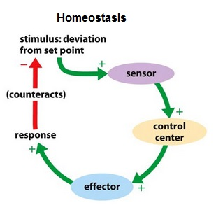
homeostatic REGULATION
Maintaining a stable internal environment requires constant monitoring and adjustments as conditions change. This adjusting of physiological systems within the body is called homeostatic regulation.
Homeostatic control systems have 3 components:
1) Sensor / Receptor
2) Control Center
3) Effector
Stimulus is the change that occurs in the environment which is detected by the Receptor/sensor. The Receptor gathers the data and then messages the Control center which compares sensor input with set point, then instructs the Effector to restore normal balance.
Notes:
The human body maintains hundreds of physiologically controlled parameters (variables) close to a setpoint. The body uses control systems to maintain these parameters at or close to their respective setpoint.
Variables are parameters that are monitored and controlled or affected by the feedback system.
Receptors (sensors) detect changes in the variable.
Control centers (integrators) compare the variable in relation to a set point and signal the effectors to generate a response. Control centers sometimes consider information other than just the level of the variable in their decision-making, such as time of day, age, external conditions, etc.
Effectors execute the necessary changes to adjust the variable.

Slide 6
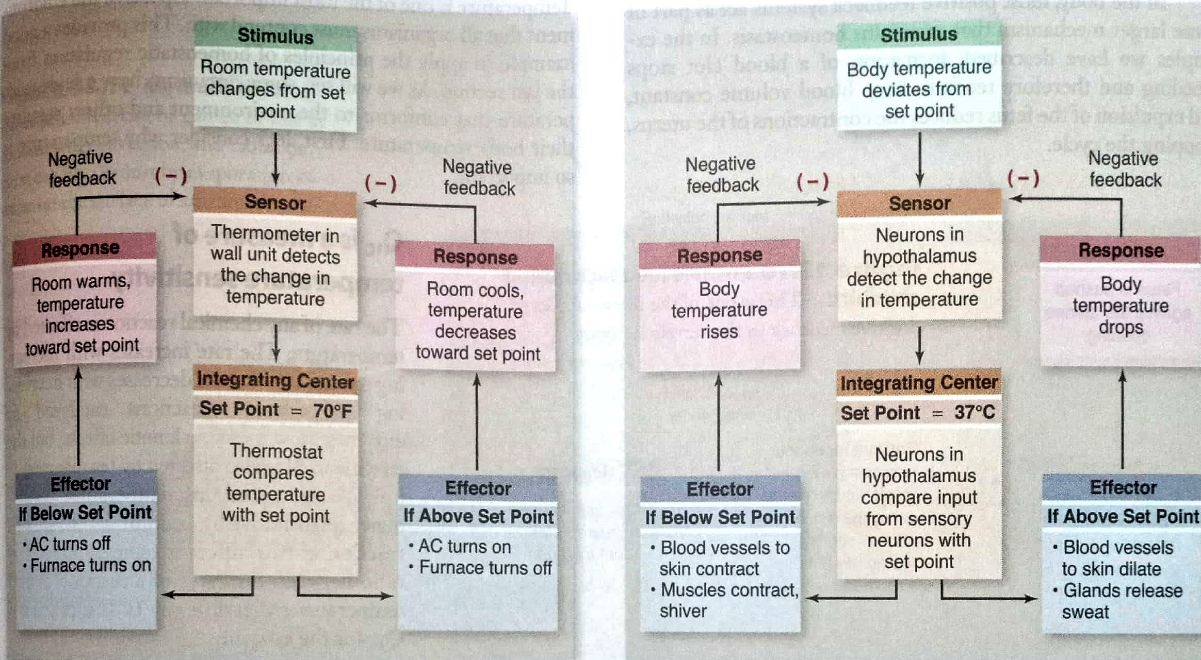
Sensory neurons
Notes:
The maintenance of homeostasis in the body typically occurs through the use of feedback loops that control the body's internal conditions.
FEEDBACK LOOP
A system used to control the level of a variable in which there is an identifiable receptor (sensor), control center (integrator or comparator), effectors, and methods of communication.
Methods of communication among the components of a feedback loop are necessary in order for it to function. This often occurs through nerves or hormones, but in some cases receptors and control centers are the same structures, so that there is no need for these signaling modes in that part of the loop.
Positive feedback is a process in which the end products of an action cause more of that action to occur in a feedback loop. This amplifies the original action.
It is contrasted with negative feedback, which is when the end results of an action inhibit that action from continuing to occur.

Slide 7
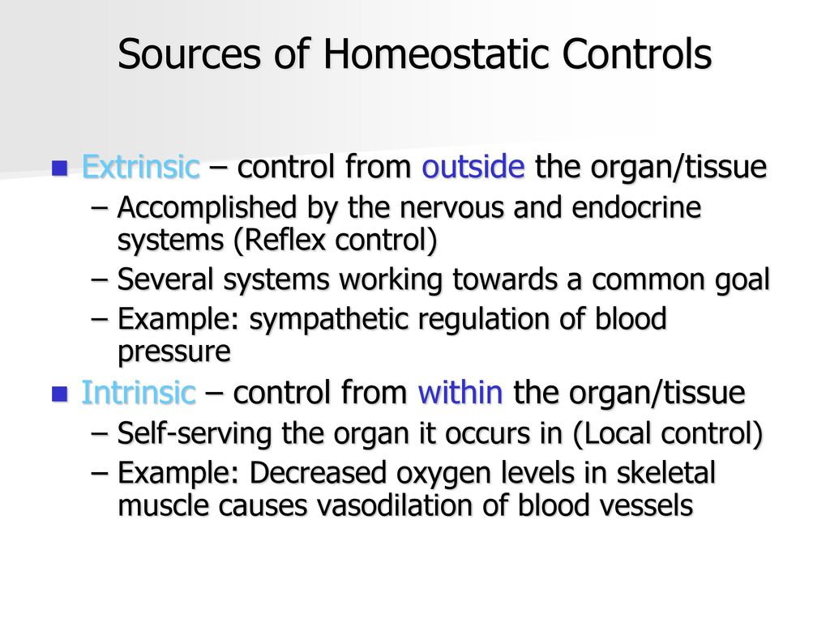
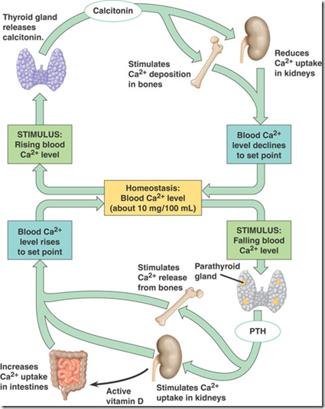
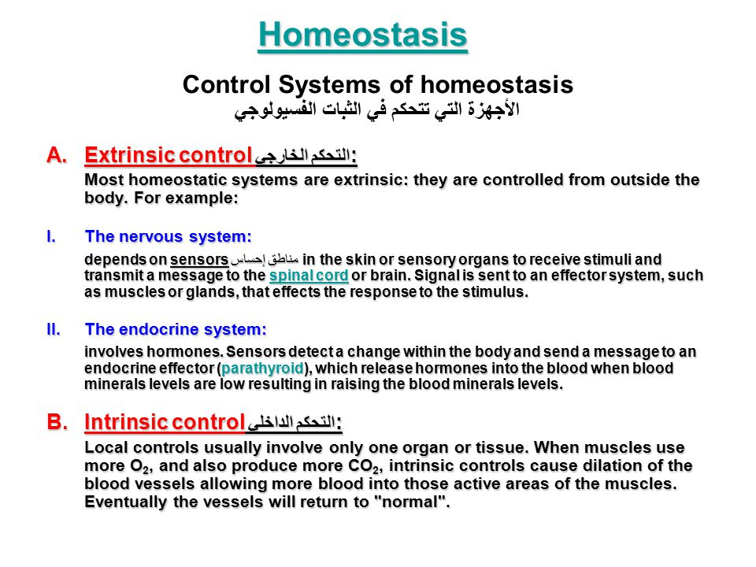
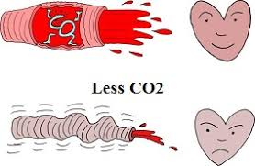
Types of homeostaTic regulation
Examples are exercising, regulation of body temperature, blood pressure, blood calcium levels etc
Notes:
When one works out, based on the level of activity, the nervous system sends signals to your heart to beat faster to maintain proper oxygenation of cells.
Sensors detect low blood calcium levels and sends a message to parathyroid gland, which releases parathyroid hormone (PTH) into blood. PTH causes bone to release calcium into the blood stream, raising the blood calcium levels and ultimately shutting down further production of PTH

Slide 8
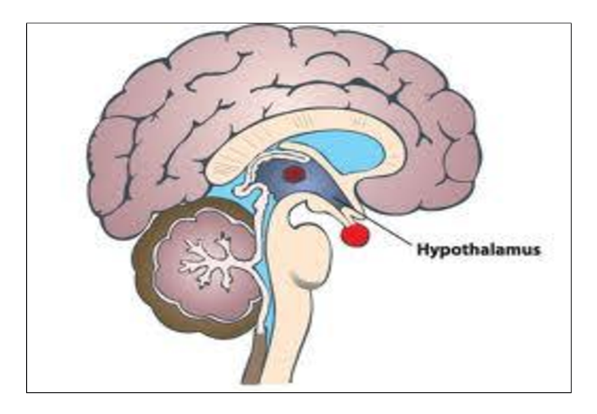
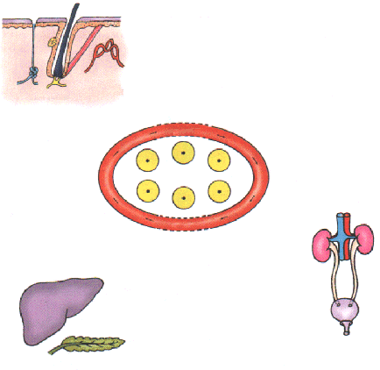
Organs involved in Homeostasis
There is no specific organ which controls homeostasis.
The skin, kidneys, liver, endocrine system, nervous system and sensory system all play a part in maintaining the internal environment within narrow limits.
The hypothalamus is involved to a degree in each of these regulations
1. Skin (helps in temperature regulation)
2. Kidneys (helps in the water concentration of the body)
3. Brain (MASTERMIND)
4. Pancreas (produces insulin that helps in the control of sugar concentration in the blood)

Slide 9
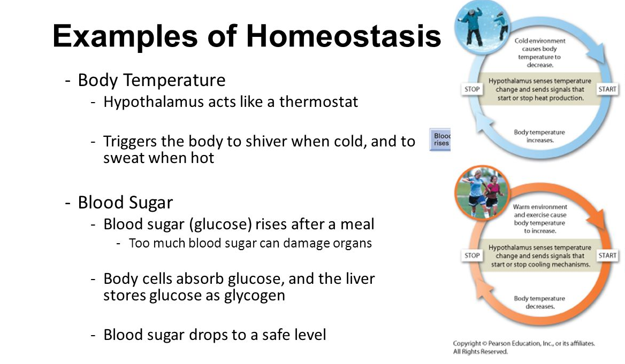
Notes:
ARTIFICIAL HOMEOSTASIS (not in course)
Air conditioning is a technological system that can be described in terms of a feedback loop. The thermostat senses the temperature, an electronic interface compares the temperature against a set point (the temperature that you want it to be). If the temperature matches or is cooler, then nothing happens. If the temperature is too hot, then the electronic interface triggers the air-conditioning unit to turn on. Once the temperature is lowered sufficiently to reach the set point, the electronic interface shuts the air-conditioning unit off.
Cruise control is another technological feedback system. The idea of cruise control is to maintain a constant speed in your car. The car’s speed is determined by the speedometer and an electronic interface measures the car’s speed against a set point chosen by the driver. If the speed is too slow, the interface stimulates the engine; if the speed is too fast, the interface reduces the power to the tires.

Slide 10
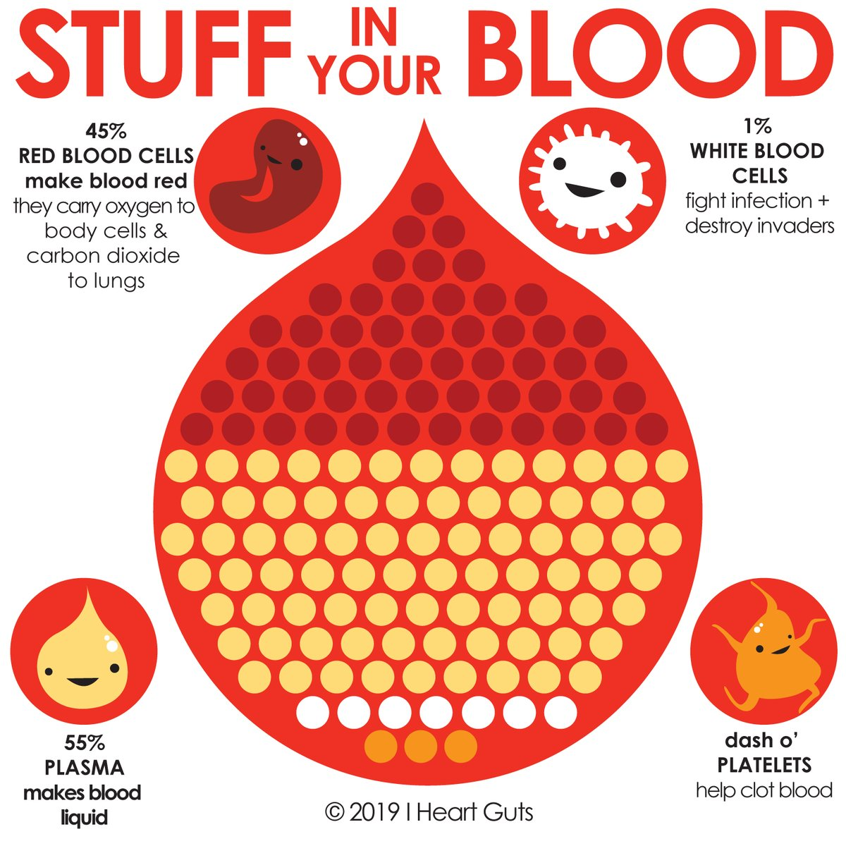
QUESTIONS
Elaborate the term homeostasis with an example? What are the consequences of an imbalanced homeostatic state in the body?
What are the components of a homeostatic system ?
State the importance of homeostasis and the factors that are regulated to maintain a steady environment inside the organism.
Describe the different steps involved in blood clotting.
What are the different ways in which homeostasis is regulated in the body? Give examples.

